Slide 1


Slide 2
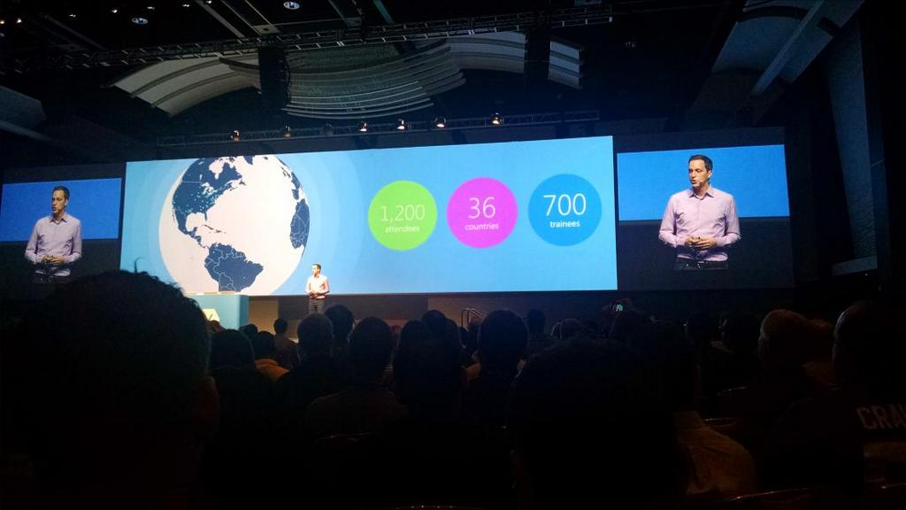
>1200
Attendees!
Notes:
Evolve 2014 was huge! More than 1200 developers joined Xamarin in Atlanta this year for 3 days of Evolve Conference.

Slide 3
36
Countries!
Notes:
Developers flew in from all over the world from more than 36 countries.

Slide 4
Training

Slide 5
700
Trainees!
Notes:
Before Evolve even started there was 2 days of intense training with more than 700 Trainees. This is actually larger than the total amount of attendees at last years Evolve!

Slide 6

Notes:
2 Days of around the clock training!

Slide 7
Sessions

Slide 8

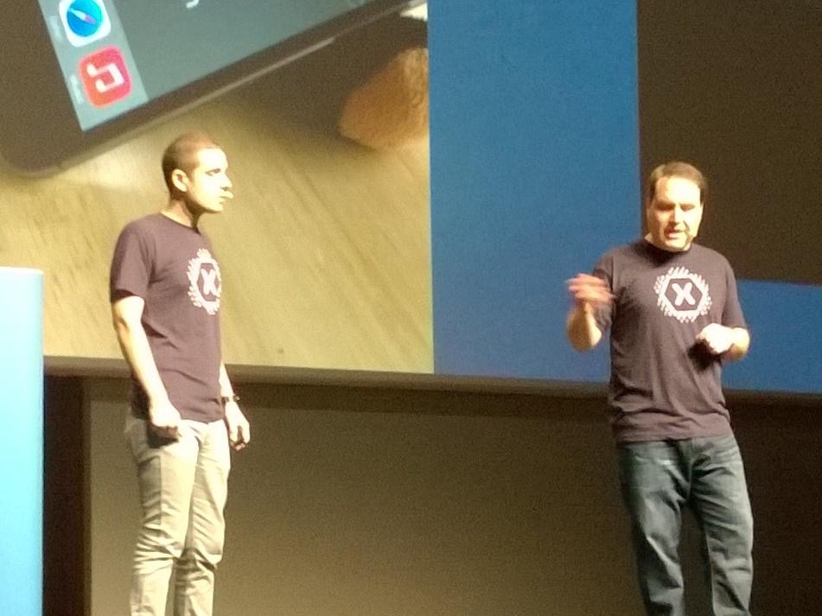
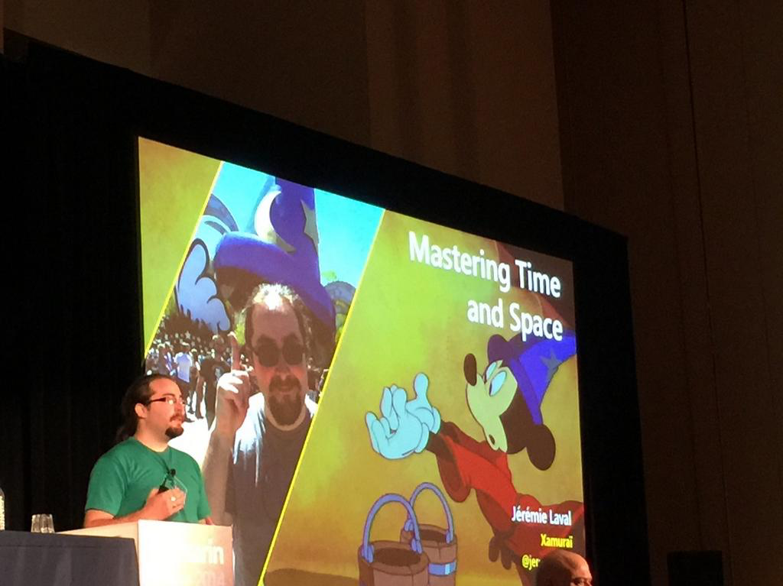
Sessions
Over 70 sessions (plus training)
Various mobile topics ranging from enterprise development to gaming
Videos available at:
http://xamarin.com/evolve

Slide 9
Darwin Lounge
Notes:
The Darwin Lounge is by far one of the most talked about aFspects of Evolve. A Place to sit back, relax, game, hack, and chat with experts.

Slide 10
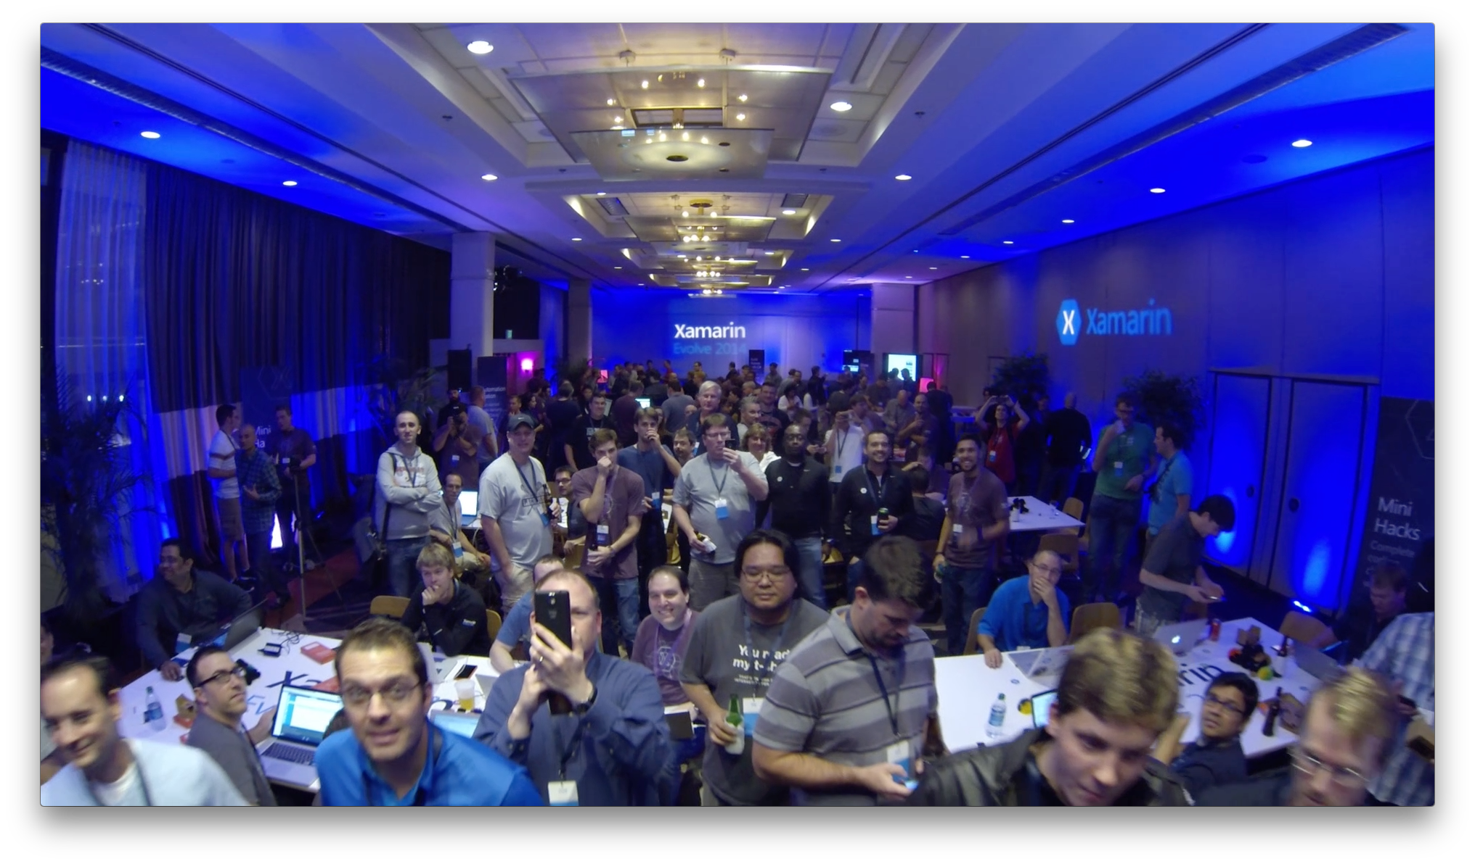
Notes:
Filled around the clock with hundreds of Attendees. This shot was captured with a Drone!

Slide 11
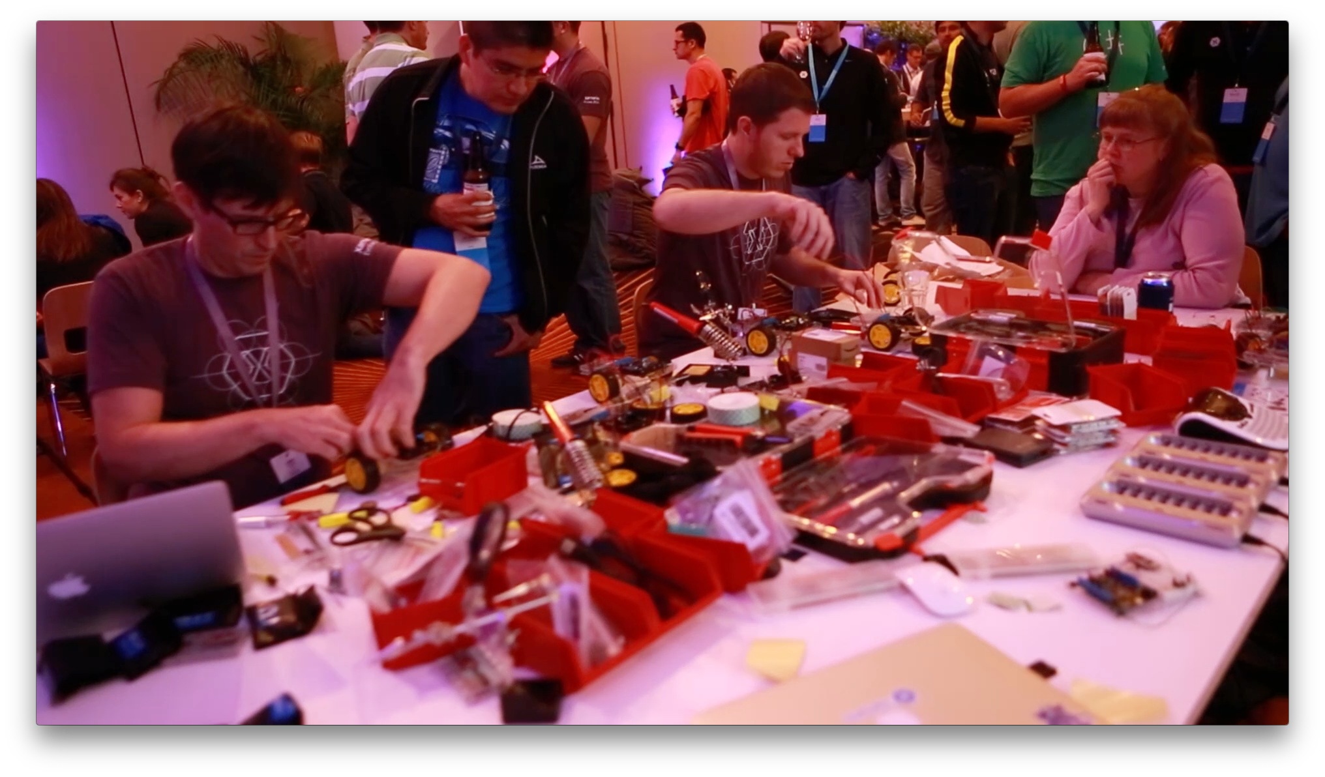
Notes:
This year brand new was the ability to build your own Xamarin controlled Bluetooth robot!
See more at https://github.com/xamarin/monkey.robotics

Slide 12
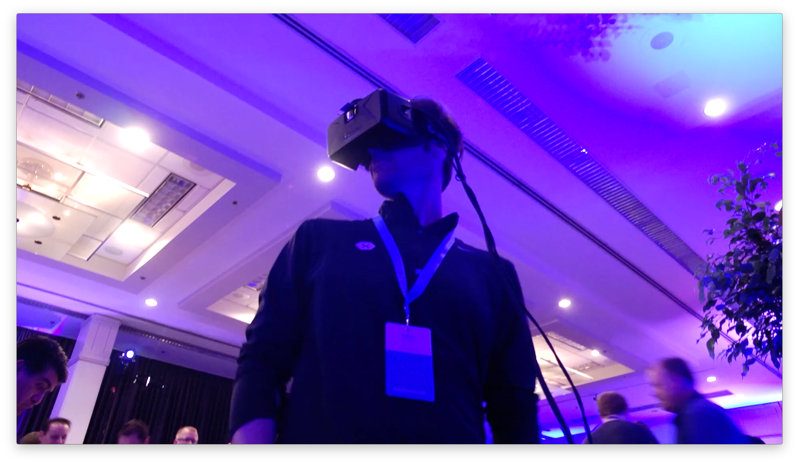

Slide 13
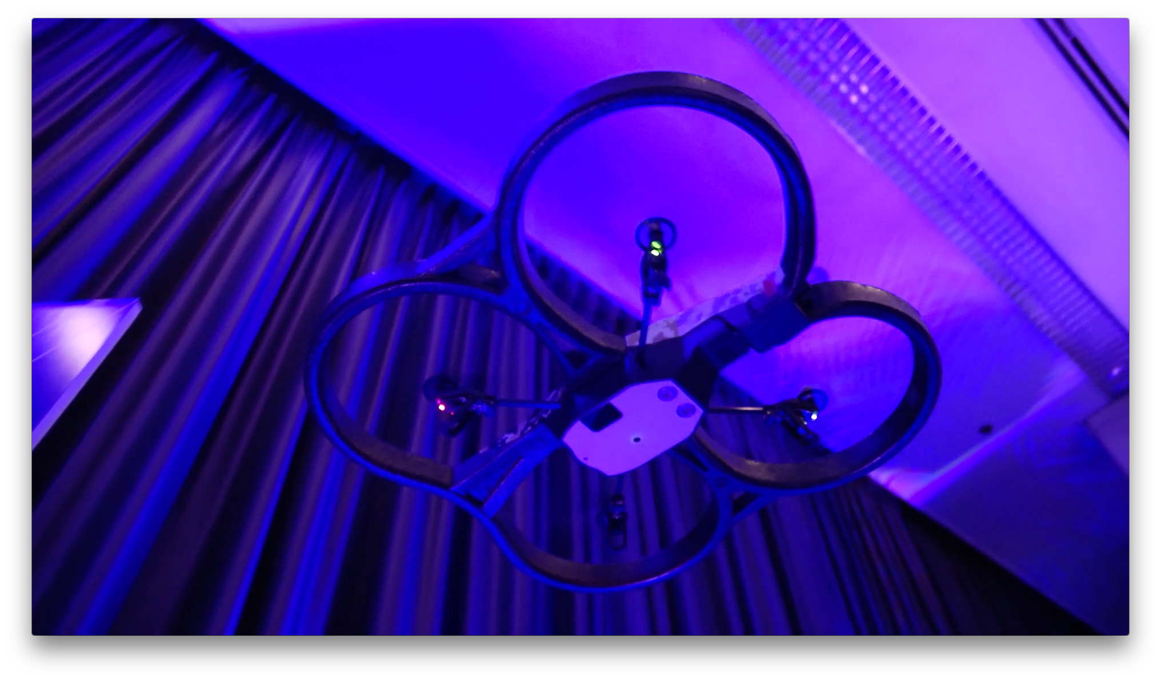

Slide 14


Slide 15
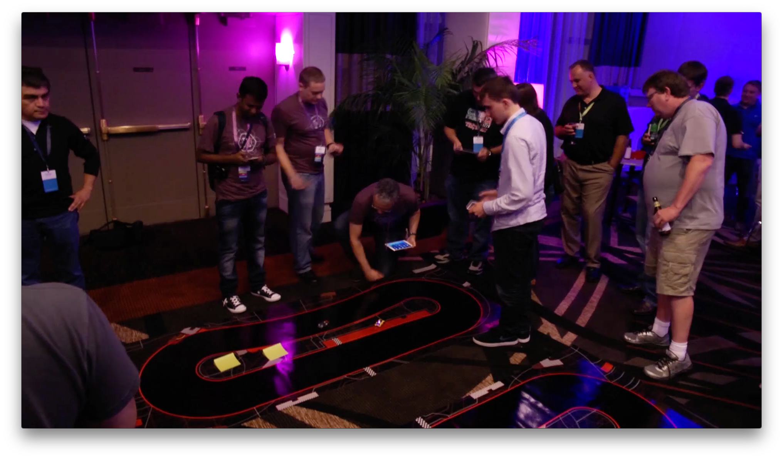

Slide 16
Fun

Slide 17

Notes:
Welcome Reception over Coal Oven Pizza kicked off Evolve!

Slide 18

Notes:
Attendees then stepped inside the world’s largest aquarium for a fun filled night of food and tons of wildlife!

Slide 19


Slide 20

Notes:
To close it off was an awesome BBQ with games and prizes for everyone.

Slide 21


Slide 22

Notes:
Of course there was an epic F# vs C# showdown!

Slide 23

Keynote Annoucements
Notes:
There were several key announcements at this years Keynote. Let’s go through them one at a time!

Slide 24
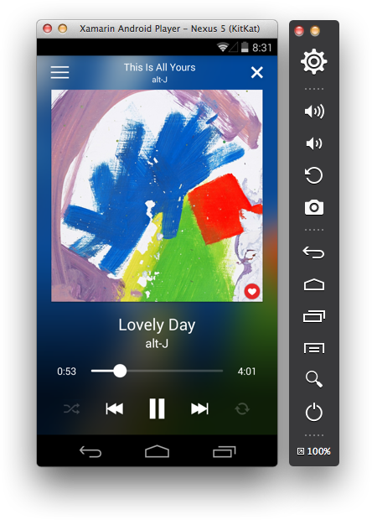
Xamarin Android Player
Super fast hardware accelerated simulator
Available on Mac and PC
Free for Xamarin subscribers
Xamarin.com/android-player
Notes:
The biggest pain point for Android developers has always been the Android Emulators.
Even though the emulators were created by Google for developers, Xamarin came to the rescue to solve this problem and release the Xamarin Android Player
Hardware accelerated for both PC and Mac with special features such as: Simulating battery levels and GPS as well as screen shots.

Slide 25
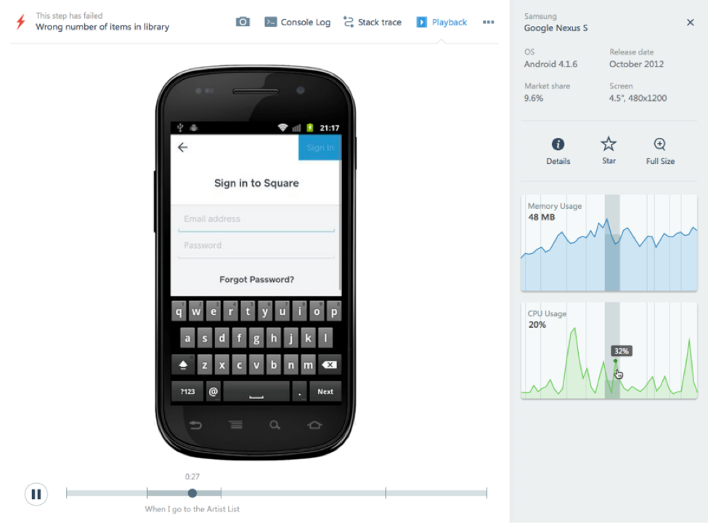
Test Cloud
New Features
Xamarin.UITest
Improved Capture Tools
Test Execution Enhancements
Notes:
There were several Test Cloud enhancements including integration into Visual Studio, Parallel Test Executions.
For everyone came

Slide 26
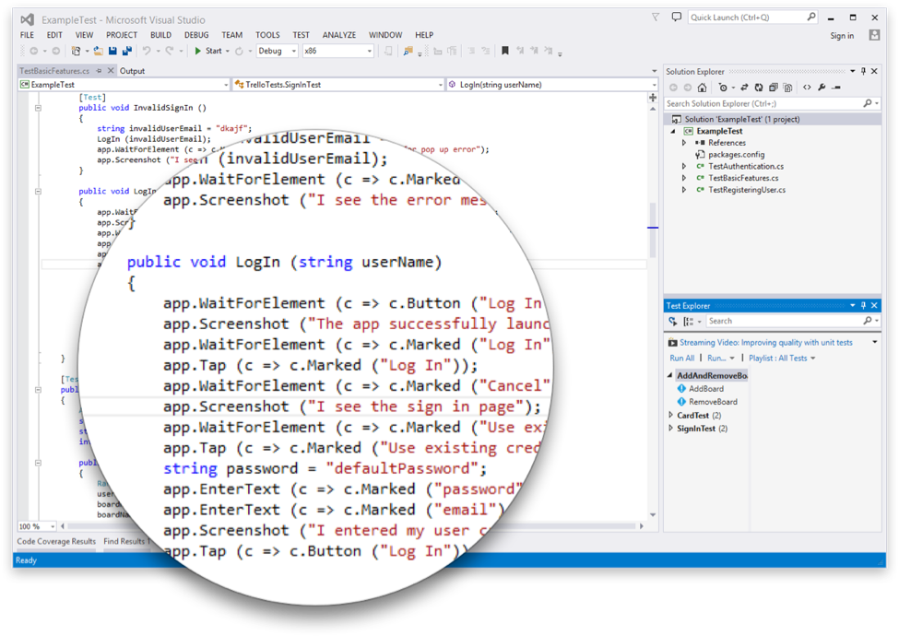
Test Cloud
New Features
Create Automated User Interface tests all in C#
Upload to the Test Cloud or run against a Device or Simulator
Run directly from Visual Studio or Xamarin Studio
Exposed via a NuGet Package
Free to use a Simulator*
Notes:
There were several Test Cloud enhancements including integration into Visual Studio, Parallel Test Executions.
For everyone came

Slide 27
Demo

Slide 28

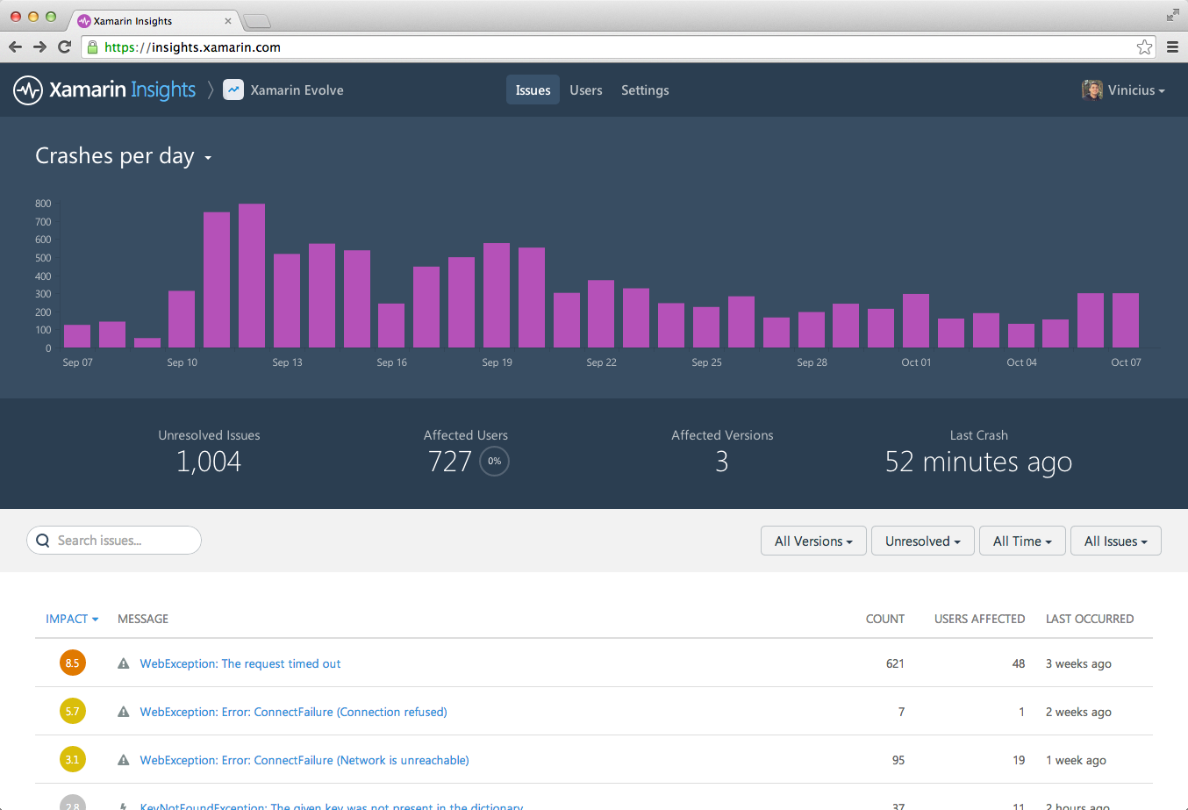
Real-time Monitoring for your Apps
iOS, Android, Mac, and Windows
Xamarin.com/Insights
Notes:
What happens after you ship your app? How are you getting feedback from your app for crashes, warnings, or other analytics?
This is where Xamarin Insights comes in. Your one stop shop for real-time monitoring of your applications.
Compatible with iOS, Android, Mac, and Windows with a common API and NuGet/PCL compatible!

Slide 29
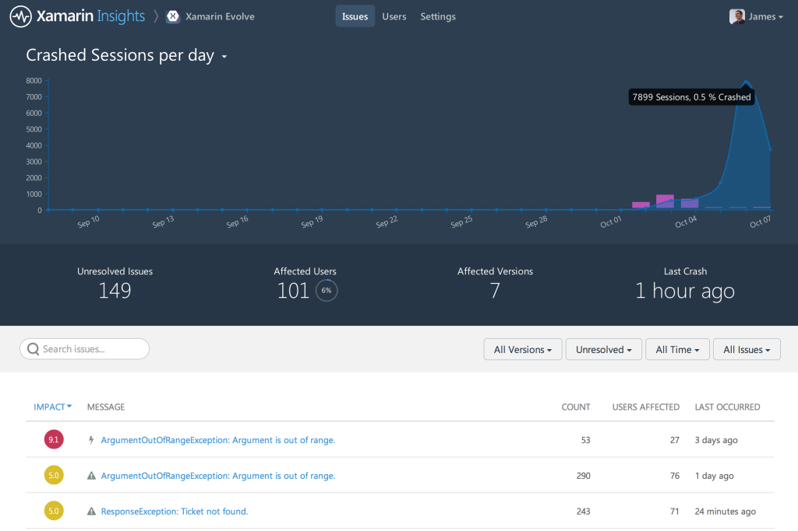
Report
Automatically report any uncaught managed or native exception.
Report your own caught exceptions with simple cross-platform API

Slide 30
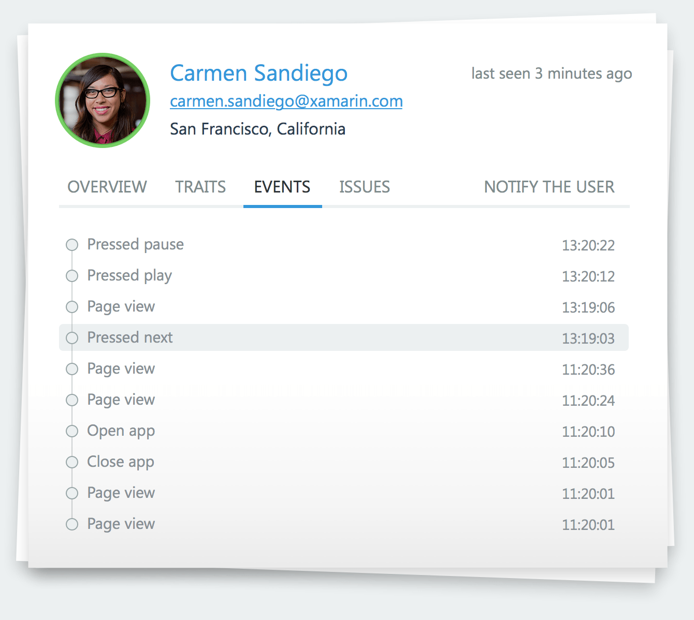
Track
Track any event that occurs in your application.
Even track performance of how long an operation takes.

Slide 31
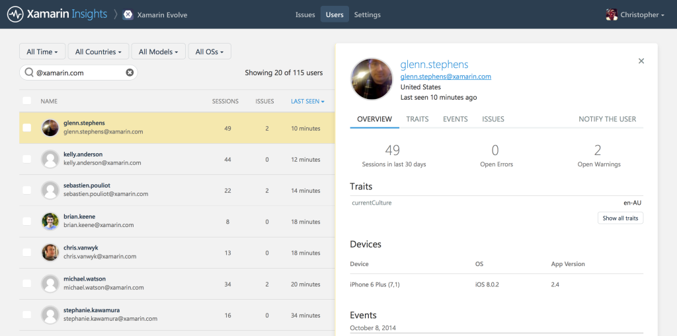
Identify
Combine event tracking with user identification to resolve issues faster.

Slide 32





Integrate
Simple integrations into popular services for mission critical notifications.

Slide 33
Demo

Slide 34
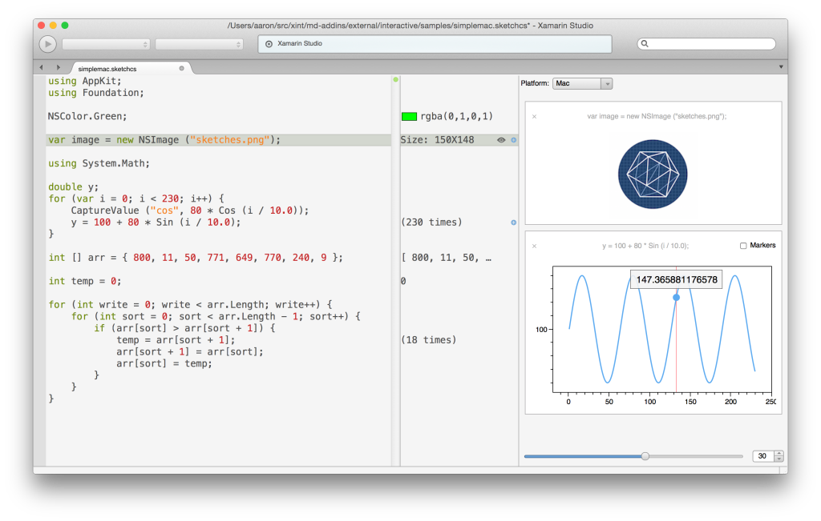
Sketches
Live Coding Environment
Xamarin Studio
VS coming soon
developer.xamarin.com/guides/cross-platform/sketches/
Notes:
We have had a straight C# REPL(Read-Eval-Print Loop) for a while now, however Sketches takes it to an entirely new level.
This is a live interactive coding environment for:
iOS,
Android
Xamarin.Forms!
Write code and see it live before your eyes!

Slide 35
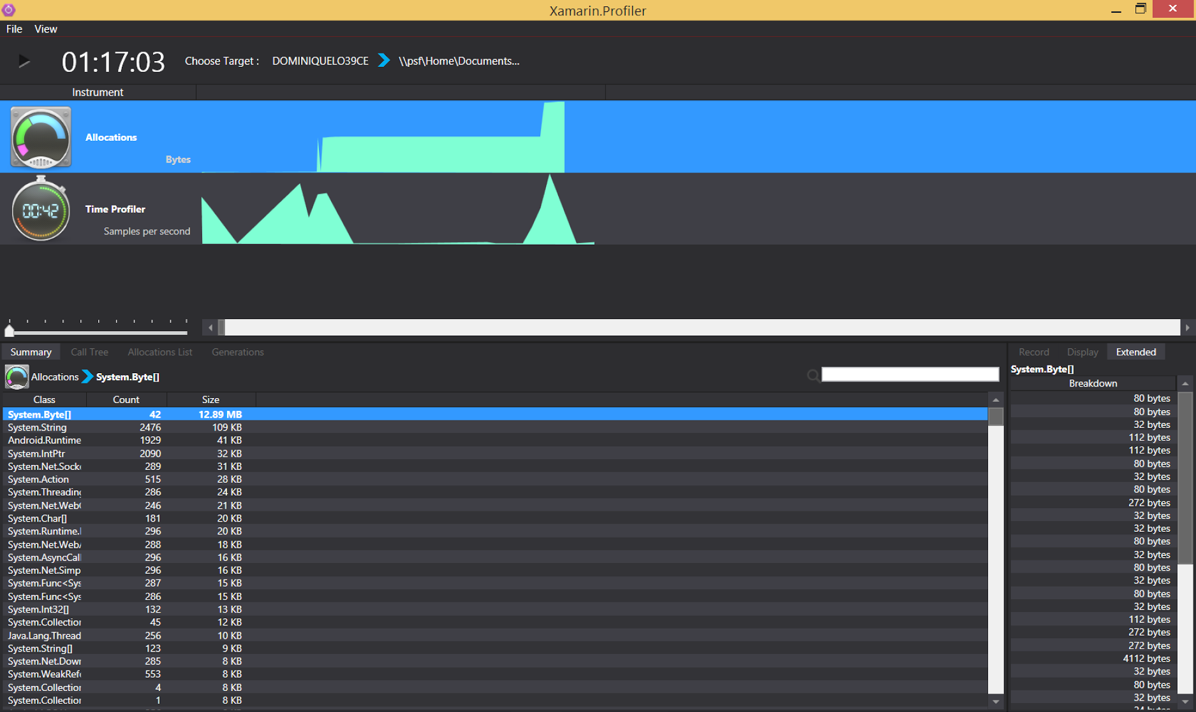
Xamarin Profiler Preview
Analyze and Polish your C# Mobile Apps
iOS, Android, and Xamarin.Forms
Windows or Mac
Xamarin.com/profiler
Notes:
The Xamarin Profiler enables developer to dive deep into their mobile apps to analyze and finely tune every last bit of performance. It has several key features.
Available for Xamarin Business Edition Subscribers

Slide 36
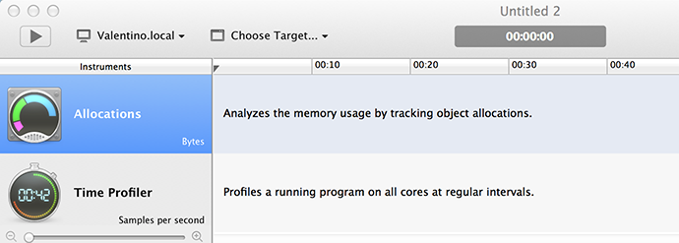
Two Key Instruments
Allocations
Time Profiler

Slide 37
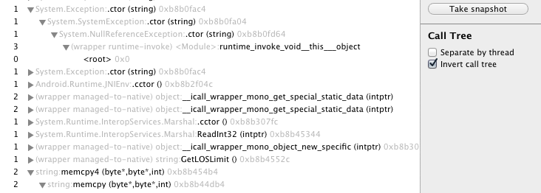
Call Tree
Browse functions easily
Option to invert and separate by threads

Slide 38
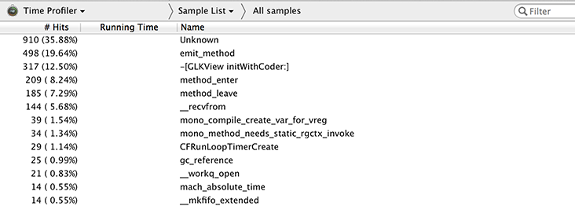
Sampling
See where your app is spending the most time.

Slide 39
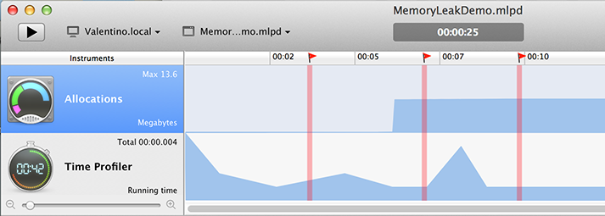
Memory Snapshots
See how memory is used at different points in time.

Slide 40
Demo

Slide 41
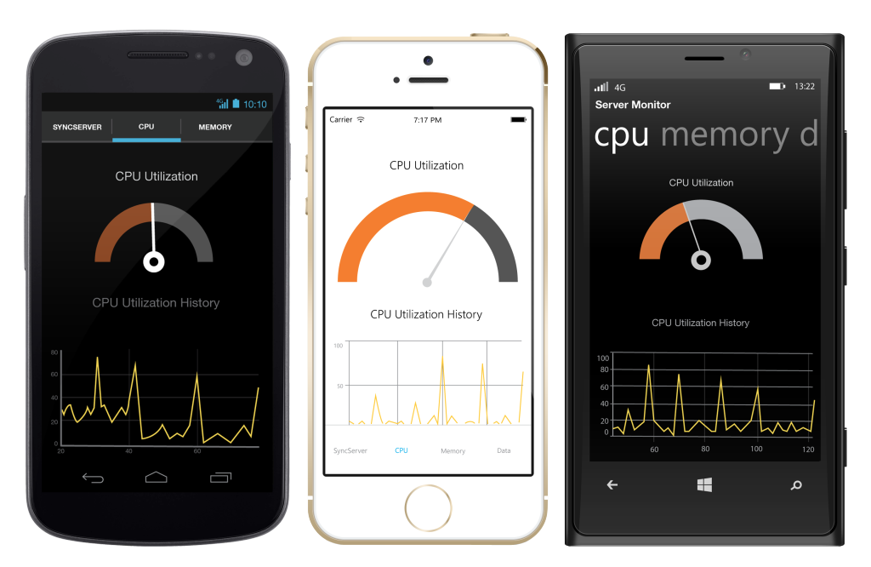

Xamarin.Forms Controls
blog.xamarin.com/enterprise-component-vendors-join-xamarin.forms-ecosystem/
Notes:
Several enterprise component vendors announced their support for Xamarin.Forms. Enabling developers to use beautiful charts, grids, and other controls from their shared C# code.

Slide 42
IBM Partnership
IBM MobileFirst SDK for Xamarin
IBM MobileFirst Add-Ons for Xamarin Studio and Visual Studio
xamarin.com/ibm
Notes:
IBM MobileFirst SDK for Xamarin: A pre-built software library that Xamarin and IBM developers can embed in their mobile apps to connect, secure and manage the apps using IBM Worklight, a part of the IBM MobileFirst portfolio.
IBM MobileFirst Add-Ons for Xamarin Studio and Visual Studio: Extensions that enable developers to configure and access the IBM Worklight server from a single environment.

Slide 43
Even More!

Slide 44
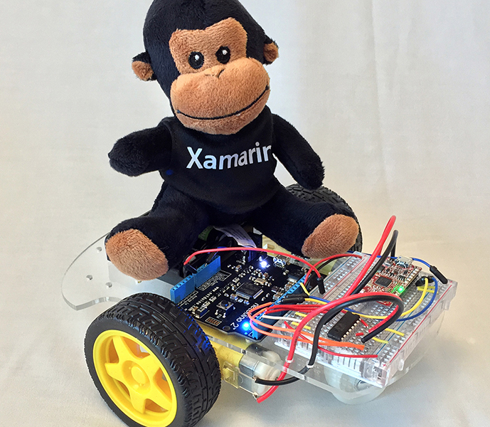
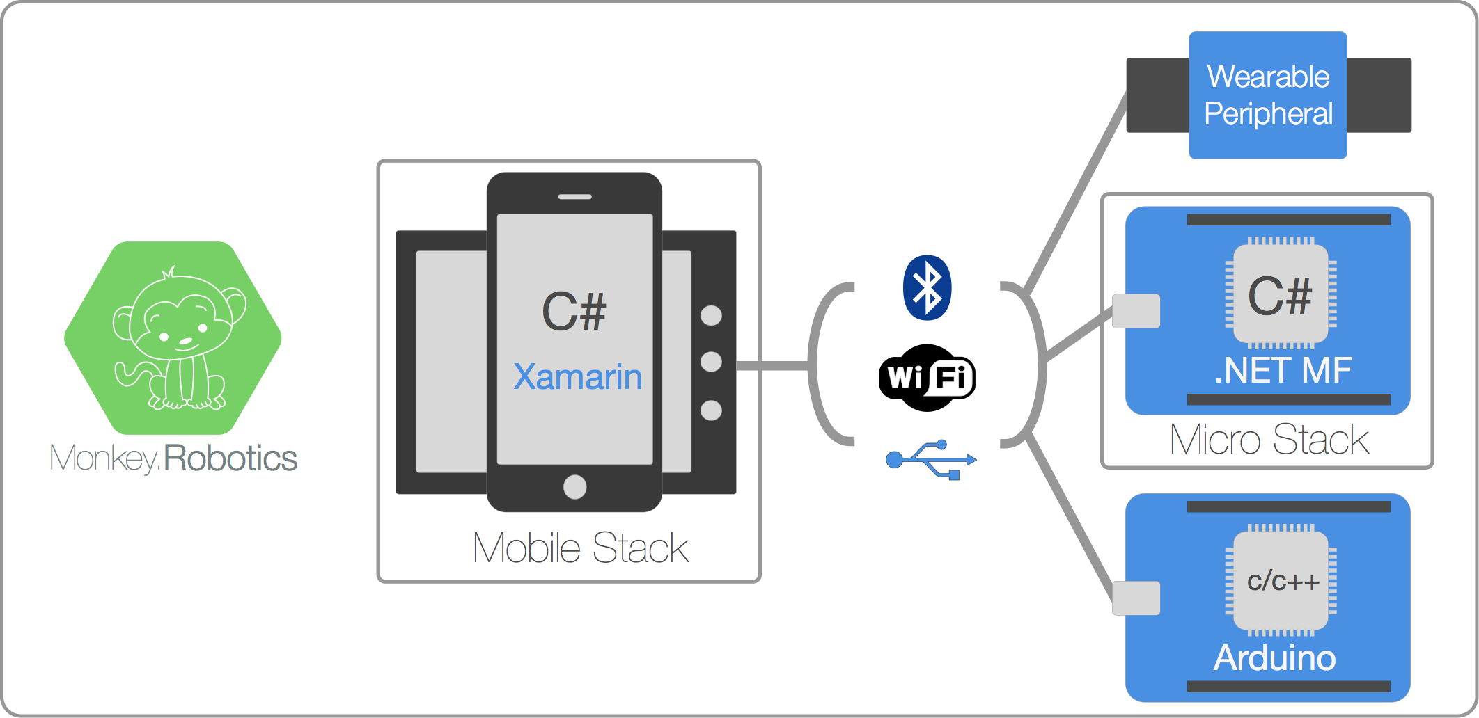
https://github.com/xamarin/monkey.robotics
Notes:
This year brand new was the ability to build your own Xamarin controlled Bluetooth robot!
See more at https://github.com/xamarin/monkey.robotics

Slide 45
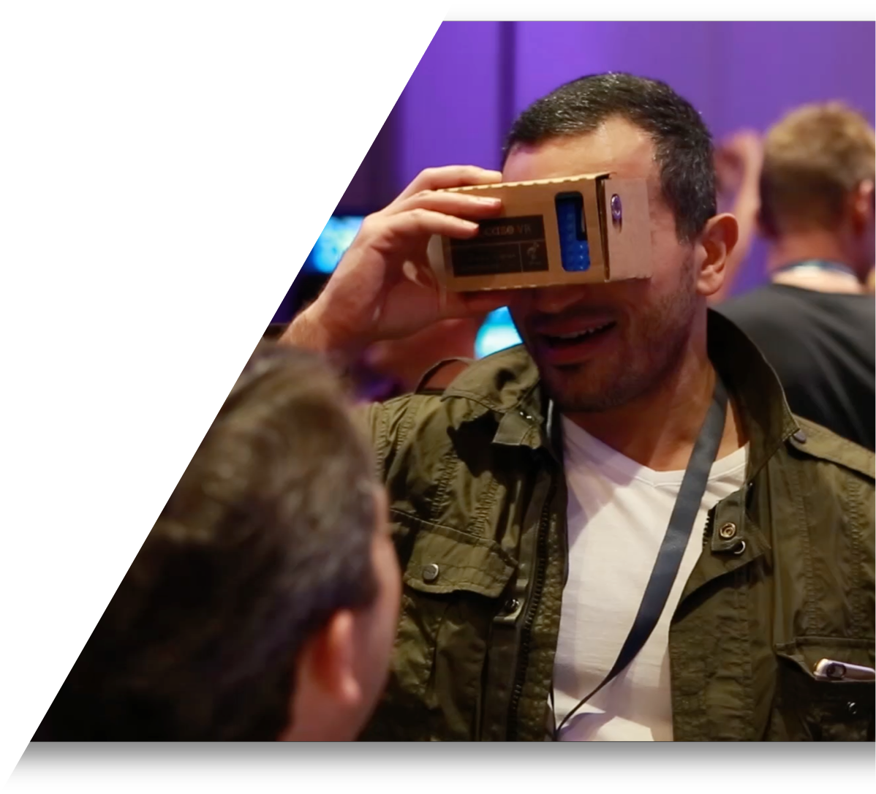
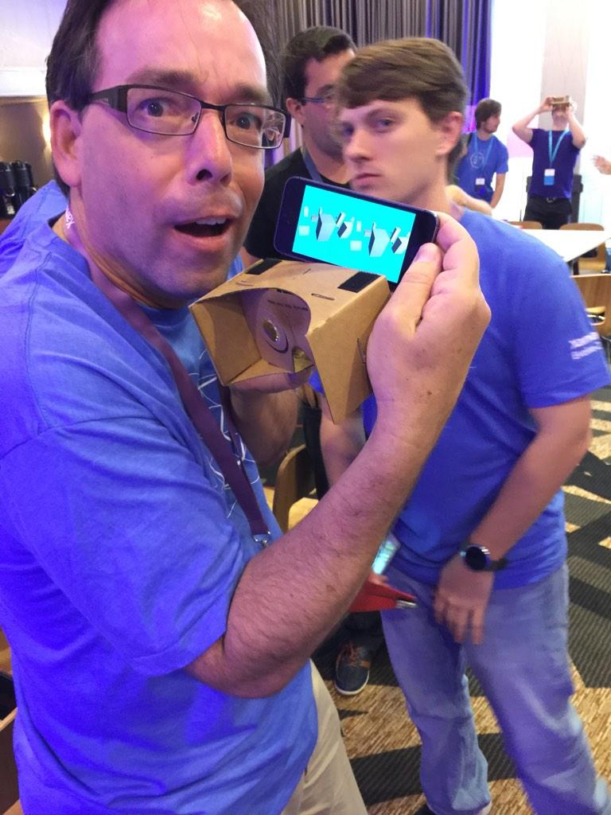
Mini Hacks
Github.com/xamarin/mini-hacks
Notes:
Attendees got to participate in 9 different Mini-hacks ranging from UITest, Cardboard, Azure Mobile Services, and many more. You can try out the mini-hacks yourself on GitHub

Slide 46
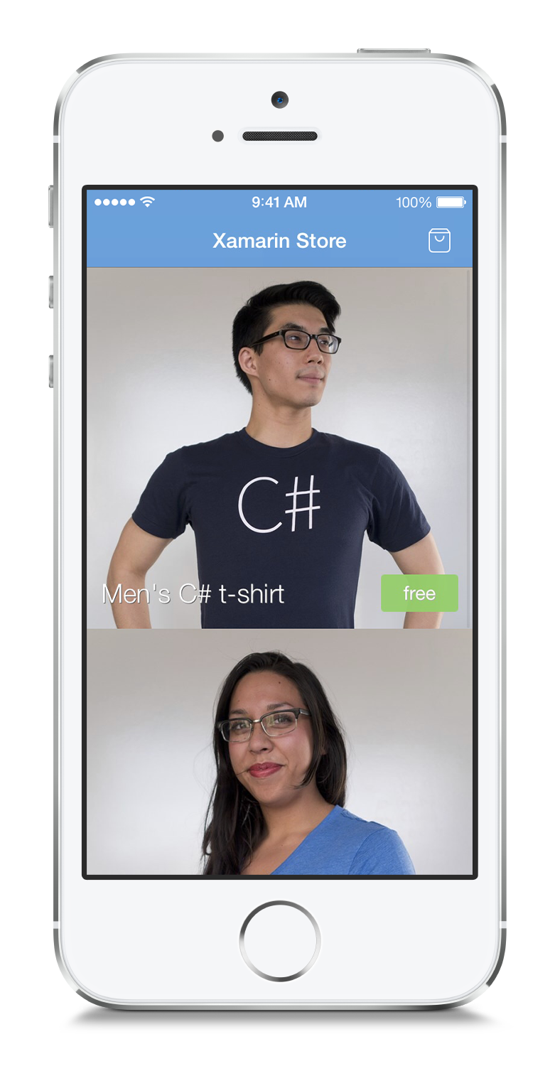
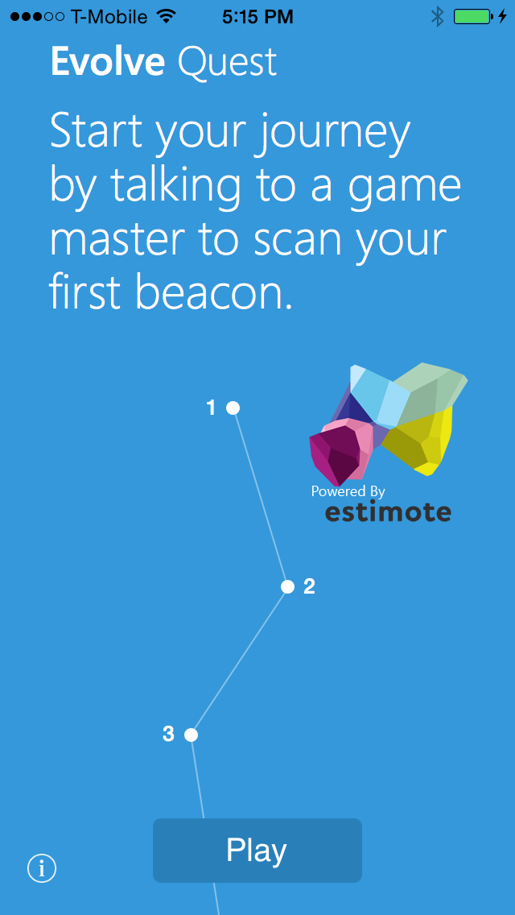
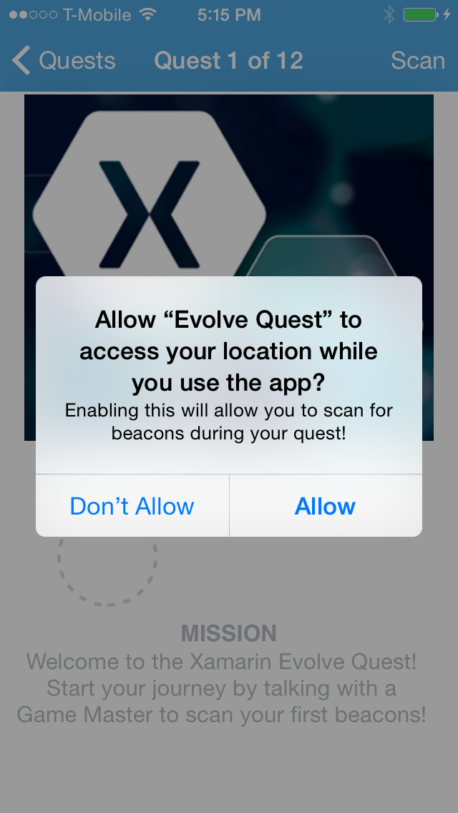
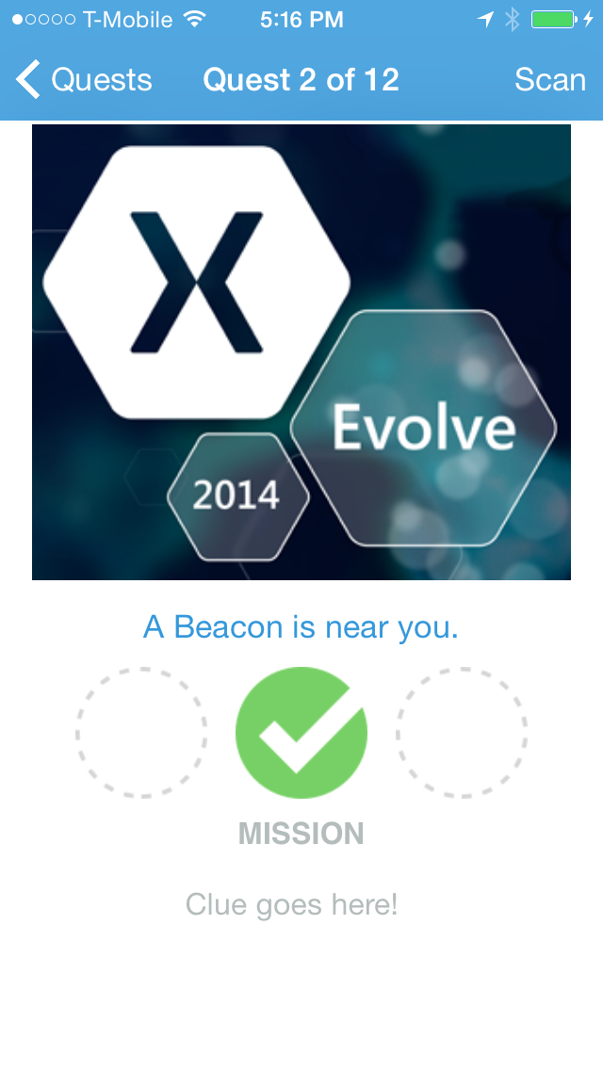
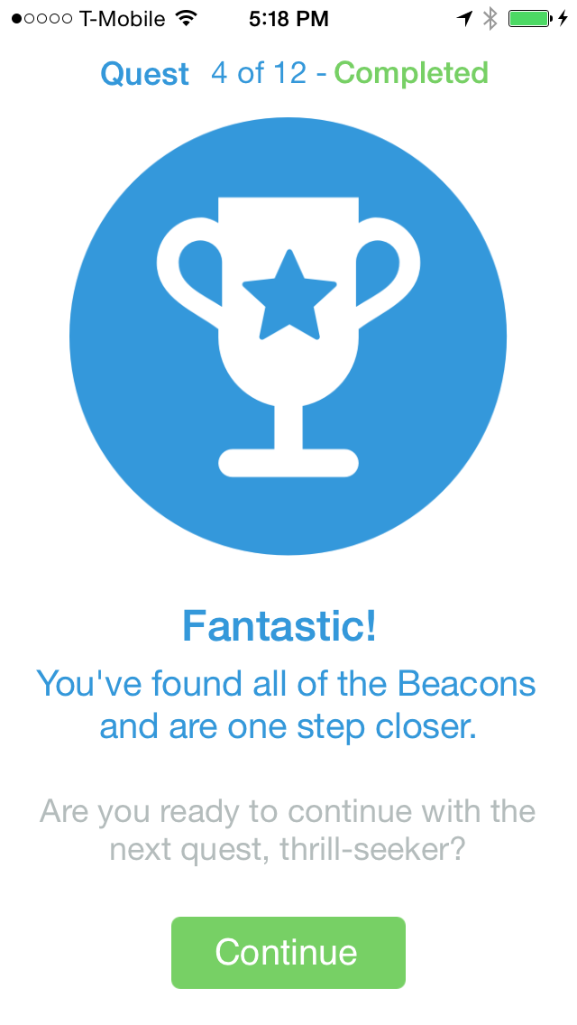
Evolve Quest App
https://github.com/xamarin/evolve-quest
Notes:
The Evolve Quest is a brand new interactive scavenger hunt based on iBeacons and QR code scanning. Attendees quested throughout evolve for a chance to win an exclusive Evolve 2014 monkey. The source code is available online!

Slide 47
See you next Evolve!
Frank Krueger
James Montemagno
@praeclrum | @JamesMontemagno

